Slide 1
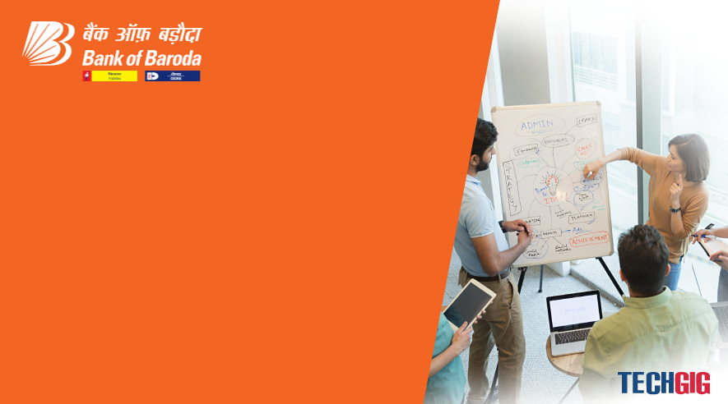

Bank of Baroda Hackathon - 2022
Technology Partner
Your Team Name : ViTech
Your team bio : The members of ViTech has a knowledge of modern technology such as Python, Database, Java, etc. Our team has a good experience of HACKATHON and has participated in SMART INDIA HACKATHON.
Date : 19-09-2022

Slide 2
Problem Statement?
Why did you decide to solve this Problem statement?
In our model, we will implement:
A conversational digital virtual assistant which will provide-
Voice assistants system for all customers.
An interactive conversation with the users.
The virtual assistant will be available in multiple languages.
Automatic updation of database based on customer feedback using AI.
Always be in customer’s touch.
Will be comptable with android devices, iOS, web portal and call banking platforms.
Will assist to complete banking process.
Customer can access all services directly.

Slide 3
User Segment & Pain Points
Which user /advertiser segment would be early adopter of your product & why?
Senior citizens, rural people, villagers, illterates and all Bank Of Baroda users would be early adopter of our project because it will benefit them in various aspects such as:
Reduce horde.
Provide accurate path and response immediately.
Increase accessibility and scalability.
Increase customer’s loyalty.
Deal and develop VA suggestions to BOB customer.

Slide 4
Pre-Requisite
What are the alternatives/competitive products for the problem you are solving?
Alternatives for the Virtual Assistant are:
Conversational Chatbot : Provide customer support and help them to solve the problems.
Customer care executive: Help customers to identify the accurate solution by physical assistant.
Technology Stacks: 1. Python 2. Java 3. Java Script 4. Database 5. NLP 6.Machine Learning 7. Azure services

Slide 5
Azure tools or resources
Azure tools or resources which are likely to be used by you for the prototype, if your idea gets selected Azure services or tools help to: 1. integrate the complete model. 2. can use the direct line channel to integrate VA into mobile app, webpage or in any device. 3. host a web application with azure app services.

Slide 6
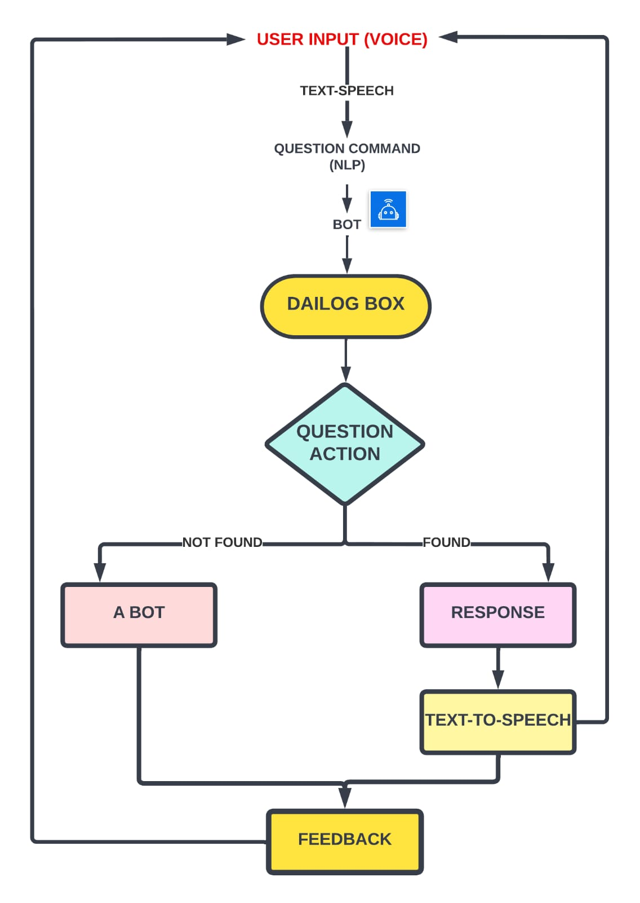
Any Supporting Functional Documents
Present your solution, talk about methodology, architecture & scalability
Architecture of the model:
Methodology of the model:
Work on the bases of user input (Text or Voice Format).
Given input will understand by the bot through backend algorithms.
A genuine Output will deliver by the bot which will conformable
to understanding by the user.
Scalability of the model:
Digitalized bot is a very new concept in the banking sector.
This concept will helpful for the senior citizens for reducing the
effort of moving around the banks for knowing about some minor
information.
The will Product represents the theme of digital india which is a
growing field.

Slide 7
Key Differentiators & Adoption Plan
How is your solution better than alternatives and how do you plan to build adoption?
Our solution is better than alternatives because:
It reduces language barrier.
It engage customer experience according to their queries.
It provides more security.
It reduces dependencies for the customer.
Plan to build adoption:
Enable voice assistant(bot) option parallel with calling(call center).
Make an app in which enable an option of virtual assistant with conversational chatbot.
Provide virtual assistant on website and desktop for better experience of the user.

Slide 8
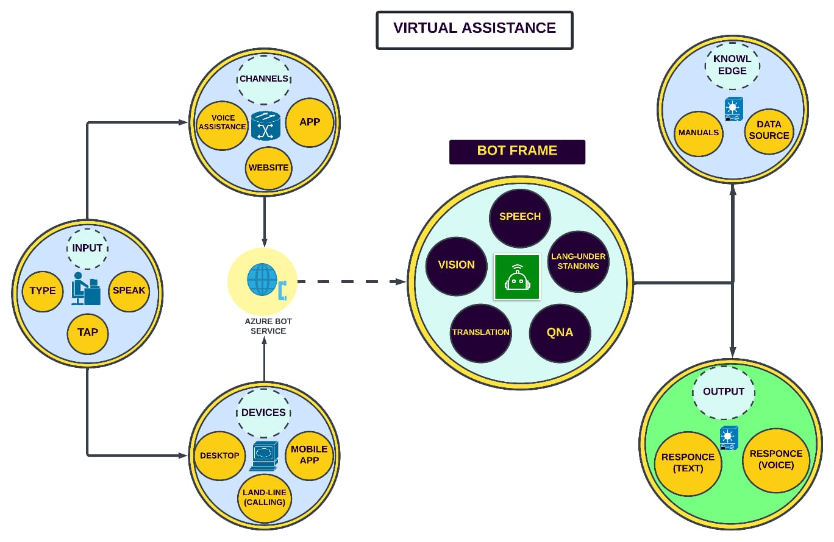
GitHub Repository Link & supporting diagrams, screenshots, if any
How far it can go?
Github repository link: https://github.com/Yashikagoyal2105/Yashika__ViTech.git

Slide 9
Thank You
Team member names:
Team Member1- Yashika Goyal
Team Members2- Kunal
Team Member3- Shashank
Team Member4- Kaushal
Mentor- Dr. Hari Mohan Rai

